Slide 1
SDLC
Software Development Life Cycle
What is Software- is a set of instructions or programs instructing a computer to do specific tasks.
Software is often divided into three categories:

Slide 2
SDLC
System software serves as a base for application software. System software includes device drivers, operating systems (OSs), compilers, disk The system software is usually written in C programming language.
Programming software is a set of tools to aid developers in writing programs. The various tools available are compilers, linkers, debuggers, interpreters and text editors.
Application software is intended to perform certain tasks. Examples of application software include office suites, gaming applications, database systems and educational software. Application software can be a single program or a collection of small programs. three categories:

Slide 3
SDLC
Software Development Life Cycle (SDLC) is a process used by the software industry to design, develop and test high quality software.
SDLC is a framework defining tasks performed at each step in the software development process.
ISO/IEC 12207 is an international standard for software life-cycle processes.

Slide 4
SDLC
Each phase of SDLC produces deliverables required by the next phase in the life cycle. Requirements are translated into design. Code is produced according to the design. Testing should be done on a developed product based on requirement. Deployment should be done once the testing was completed
It aims to produce a high-quality system that meets or exceeds customer expectations, works effectively and efficiently in the current and planned information technology infrastructure

Slide 5
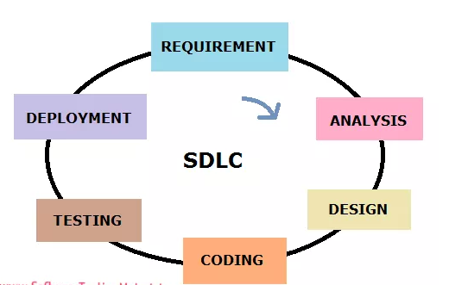
SDLC Phases

Slide 6
SDLC Phases
Requirement Phase:
Requirement gathering and analysis is the most important phase in software development lifecycle. Business Analyst collects the requirement from the Customer/Client as per the clients business needs and documents the requirements in the Business Requirement Specification (BRS) (document name varies depends upon the Organization. Some examples are Customer Requirement Specification (CRS), Business Specification (BS) etc., and provide the same to Development Team.

Slide 7
SDLC Phases
Analysis Phase:
Once the requirement gathering and analysis is done the next step is to define and document the product requirements and get them approved by the customer. This is done through SRS (Software Requirement Specification) document. SRS consists of all the product requirements to be designed and developed during the project life cycle. Key people involved in this phase are Project Manager, Business Analysist and Senior members of the Team. The outcome of this phase is Software Requirement Specification.

Slide 8
SDLC Phases
Design Phase:
It has two steps: HLD – High Level Design – It gives the architecture of the software product to be developed and is done by architects and senior developers LLD – Low Level Design – It is done by senior developers. It describes how each and every feature in the product should work and how every component should work. Here, only the design will be there and not the code The outcome from this phase is High Level Document and Low Level Document which works as an input to the next phase

Slide 9
SDLC Phases
Development Phase:
Developers of all levels (seniors, juniors, fresher's) involved in this phase. This is the phase where we start building the software and start writing the code for the product. The outcome from this phase is Source Code Document (SCD) and the developed product.

Slide 10
SDLS Phases
Testing Phase:
When the software is ready, it is sent to the testing department where Test team tests it thoroughly for different defects. They either test the software manually or using automated testing tools depends on process defined in STLC (Software Testing Life Cycle) and ensure that each and every component of the software works fine. Once the QA makes sure that the software is error-free, it goes to the next stage, which is Implementation. The outcome of this phase is the Quality Product and the Testing Artifacts.

Slide 11
SDLS Phases
Deployment & Maintenance Phase:
After successful testing, the product is delivered/deployed to the customer for their use. Deployment is done by the Deployment/Implementation engineers. Once when the customers start using the developed system then the actual problems will come up and needs to be solved from time to time. Fixing the issues found by the customer comes in the maintenance phase. 100% testing is not possible – because, the way testers test the product is different from the way customers use the product. Maintenance should be done as per SLA (Service Level Agreement)

Slide 12
SDLS Models
Types of Software Development Life Cycle Models:
Some of the SDLC Models are as follows:
Waterfall Model
Prototype
Spiral
V Model
Agile

Slide 13
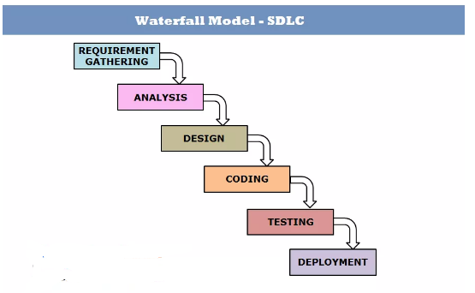
Waterfall Model
Waterfall Model is a traditional model.

Slide 14
Waterfall Model
It is Sequential Design Process, often used in SDLC, in which the progress is seen as flowing downwards like a waterfall, through the different phases such as Requirement Gathering, Feasibility Study/Analysis, Design, Coding, Testing, Installation and Maintenance. Every next phase is begun only once the goal of previous phase is completed.
This methodology is preferred in projects where quality is more important as compared to schedule or cost. This methodology is best suitable for short term projects where the requirements will not change. (E.g. Calculator, Attendance Management)

Slide 15
Waterfall Model
Advantages:
Requirements do not change nor does design and code, so we get a stable product.
This model is simple to implement. Requirements are finalized earlier in the life cycle. So there won’t be any chaos in the next phases.
Required resources to implement this model are minimal compared to other methodologies
Every phase has specific deliverable. It gives high visibility to the project manager and clients about the progress of the project.

Slide 16
Waterfall Model
Disadvantages:
Backtracking is not possible i.e.., we cannot go back and change requirements once the design stage is reached.
Change in requirements leads to change in design and code which results defects in the project due to overlapping of phases.
Customer may not be satisfied, if the changes they required are not incorporated in the product.
The end result of waterfall model may not be a flexible product

Slide 17
Waterfall Model
Disadvantages:
In terms of testing, testers involve only in the testing phase. Requirements are not tested in the requirement phase. It can’t be modified even though we identify that there is a bug in the requirement in the testing phase. It goes on till the end and leads to lot of re-work.
It is not suitable for long term projects where requirements may change time to time
Waterfall model can be used only when the requirements are very well known and fixed

Slide 18
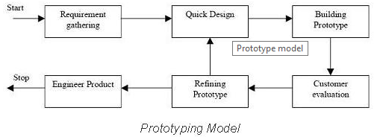
Prototype Model
The basic idea in Prototype model is that instead of freezing the requirements before a design or coding can proceed, a throwaway prototype is built to understand the requirements. This prototype is developed based on the currently known requirements

Slide 19
Prototype Model
Advantages of Prototype model:
Users are actively involved in the development
Working model of the system is provided, The users get a better understanding of the system being developed.
Errors can be detected much earlier.
Quicker user feedback is available leading to better solutions.
Missing functionality can be identified easily
Confusing or difficult functions can be identified

Slide 20
Prototype Model
Advantages of Prototype model:
Leads to implementing and then repairing way of building systems.
Practically, this methodology may increase the complexity of the system as scope of the system may expand beyond original plans.
Incomplete application may cause application not to be used as the full system was designed Incomplete or inadequate problem analysis

Slide 21
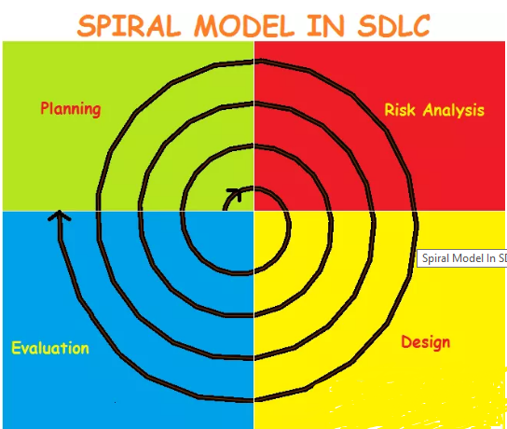
Spiral Model
Combination of both Prototype and Sequential

Slide 22
Spiral Model
Spiral model works in an iterative nature. It is a combination of both Prototype development process and Linear development process (waterfall model). This model place more emphasis on risk analysis. Mostly this model adopts to the large and complicated projects where risk is high. Every Iteration starts with a planning and ends with the product evaluation by client.

Slide 23
Spiral Model
Spiral Model undergoes 4 phases.
Planning Phase – Requirement Gathering, Cost Estimation, Resource Allocation Risk Analysis Phase – Strengths and weaknesses of the project Design Phase – Coding, Internal Testing and deployment Evaluation Phase – Client Evaluation (Client side Testing) to get the feedback

Slide 24
Spiral Model
Advantages:
It allows requirement changes
Suitable for large and complicated projects
It allows better risk analysis
Cost effective due to good risk management
Disadvantages:
Not suitable for small projects
Success of the project depends on risk analysis phase
Have to hire more experienced resource especially for risk analysis

Slide 25
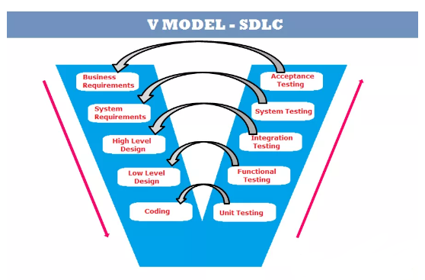
V Model
Verification and Validation (V&V) model

Slide 26
V Model
V-model is also known as Verification and Validation (V&V) model. In this each phase of SDLC must be completed before the next phase starts. It follows a sequential design process same like waterfall model.
Test team involves in the early phases of SDLC. Testing starts in early stages of product development which avoids downward flow of defects which in turns reduces lot of rework. Both teams (test and development) work in parallel. The test team works on various activities like preparing test strategy, test plan and test cases/scripts while the development team works on SRS, Design and Coding.

Slide 27
V Model
1. Once client sends BRS, both the teams (test and development) start their activities. The developers translate the BRS to SRS. The test team involves in reviewing the BRS to find the missing or wrong requirements and writes acceptance test plan and acceptance test cases.
2. In the next stage, the development team sends the SRS the testing team for review and the developers start building the HLD (High Level Design Document) of the product. The test team involves in reviewing the SRS against the BRS and writes system test plan and test cases.

Slide 28
V Model
3. In the next stage, the development team starts building the LLD (Low Level Design) of the product. The test team involves in reviewing the HLD (High Level Design) and writes Integration test plan and integration test cases.
4. In the next stage, the development team starts with the coding of the product. The test team involves in reviewing the LLD and writes functional test plan and functional test cases.
5. In the next stage, the development team releases the build to the test team once the unit testing was done. The test team carries out functional testing, integration testing, system testing and acceptance testing on the release build step by step.

Slide 29
V Model
3. In the next stage, the development team starts building the LLD (Low Level Design) of the product. The test team involves in reviewing the HLD (High Level Design) and writes Integration test plan and integration test cases.
4. In the next stage, the development team starts with the coding of the product. The test team involves in reviewing the LLD and writes functional test plan and functional test cases.
5. In the next stage, the development team releases the build to the test team once the unit testing was done. The test team carries out functional testing, integration testing, system testing and acceptance testing on the release build step by step.

Slide 30
V Model
Advantages:
Test team will be ready with the test cases by the time developers release the software which in turns saves a lot of time
Testing is involved in every stage of product development. It gives a quality product.
Total investment is less due to less or no rework.
Disadvantages:
Initial investment is more because test team involves right from the early stage.
Whenever there is change in requirement, the same procedure continues. It leads more documentation work.

Slide 31
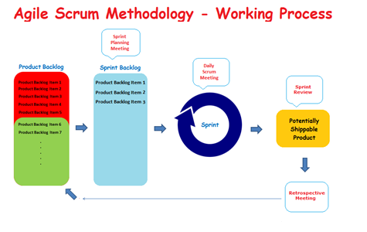
Agile Scrum Methodology
one of the popular Agile software development methods.

Slide 32
Agile Scrum Methodology
Agile Scrum Methodology is one of the popular Agile software development methods. There are some other Agile software development methods but the popular one which is using widely is Agile Scrum Methodology. The Agile Scrum Methodology is a combination of both Incremental and Iterative model for managing product development.
In Scrum, the project is divided into Sprints.

Slide 33
Agile Scrum Methodology
Sprint: Each Sprint has a specified time line (2 weeks to 1 month). This time line will be agreed by a Scrum Team during the Sprint Planning Meeting. Here, User Stories are split in to different modules. End result of every Sprint should be potentially shippable product.
The three important aspects involved in Scrum such as Roles, Artifacts and Meetings:

Slide 34
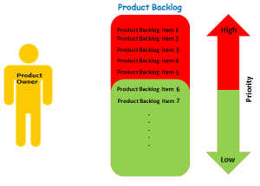
Roles in Agile Scrum
Product Owner: Product Owner usually represents the Client and acts as a point of contact from Client side. The one who prioritizes the list of Product Backlogs which Scrum Team should finish and release.

Slide 35
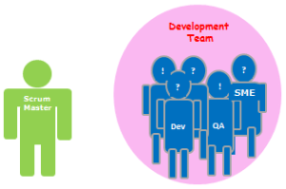
Roles in Agile Scrum
Scrum Master: Scrum Master acts as a facilitator to the Scrum Development Team. Clarifies the queries and organizes the team from distractions and teach team how to use scrum and also concentrates on Return on Investment (ROI).
.

Slide 36
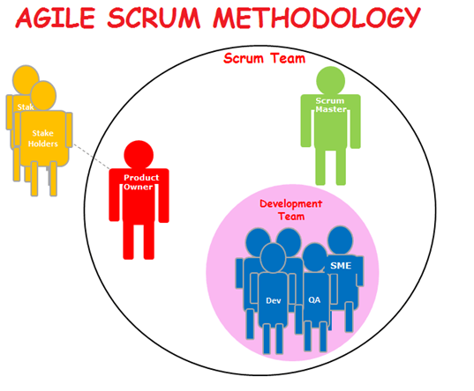
Roles in Agile Scrum
Scrum Team: A cross-functional, self-organizing group of dedicated people (Group of Product Owner, Business Analyst, Developer’s and QA’s). Recommended size of a scrum team is 7 plus or minus 2 (i.e., between 5 to 9 members in a team)

Slide 37
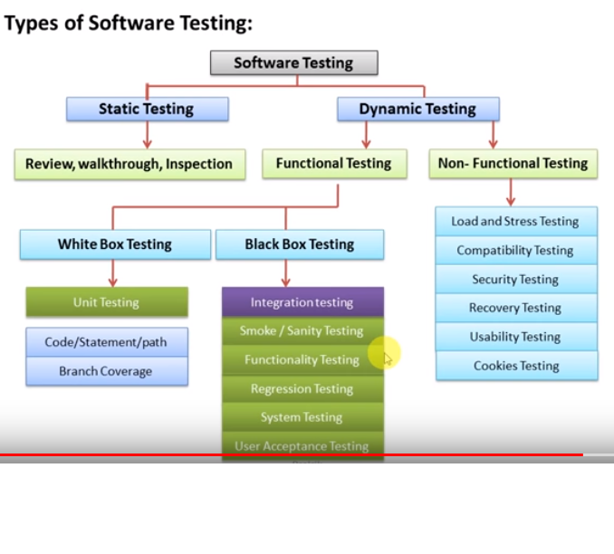
Software Testing

Slide 38
STLC
Software Test Life Cycle (STLC)
1- Requirement Analysis
Deliverables- RTM, Automation Feasibility Result
2- Test Planning
Deliverables- Test Plan, Test Strategy
3- Test Designing
Deliverables- Test Case, Test Data
4- Test Environment Setup
Deliverables- Environment Ready, Smoke Test Result

Slide 39
STLC
5- Test Execution
Deliverables- Test Case results (Pass/Fail)
6- Test Closure
Deliverables- Completed RTM with results, TC updated with results, Defect Report

Slide 40
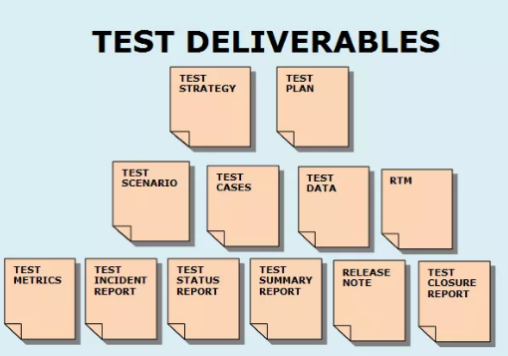
Test Deliverable
Test Deliverable: Test Deliverables are the test artifacts which are given to the stakeholders of a software project during the SDLC (Software Development Life Cycle)

Slide 41
Test Deliverable
The following are list of test deliverables:
1. Test Strategy 2. Test Plan 3. Effort Estimation Report 4. Test Scenarios 5. Test Cases/Scripts 6. Test Data 7. Requirement Traceability Matrix (RTM) 8. Defect Report/Bug Report 9. Test Execution Report

Slide 42
Test Deliverable
10. Graphs and Metrics 11. Test summary report 12. Test incident report 13. Test closure report 14. Release Note 15. Installation/configuration guide 16. User guide 17. Test status report 18. Weekly status report (Project manager to client)

Slide 43
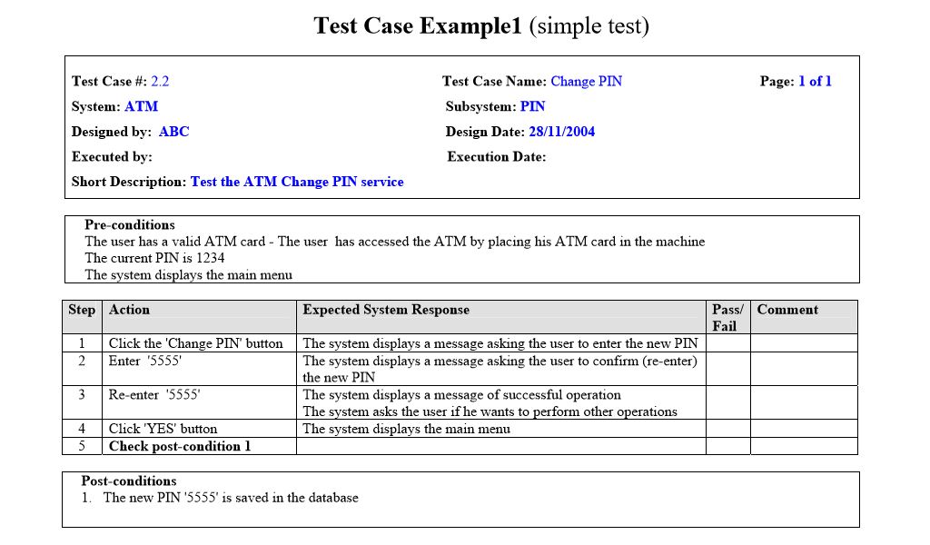

Slide 44
Thank You

